Slide 1
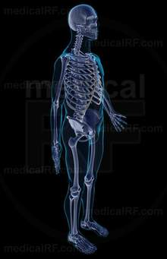
HYPERCALCEMIA & Hyperparathyroidism
Professor Dr. Khurshid Khan MBBS, M.D. (USA), F.A.C.E. (USA)
Diplomate of American Board in Diabetes, Endocrinology & Metabolism (USA) Diplomate of American Board in Internal Medicine (USA) Hypertension Specialist Certification (USA
Professor of Endocrinology Allama Iqbal Medical Col./JInnah Hospital Lahore
CONSULTANT: DOCTORS HOSPITAL & MEDICAL CTR

Slide 2
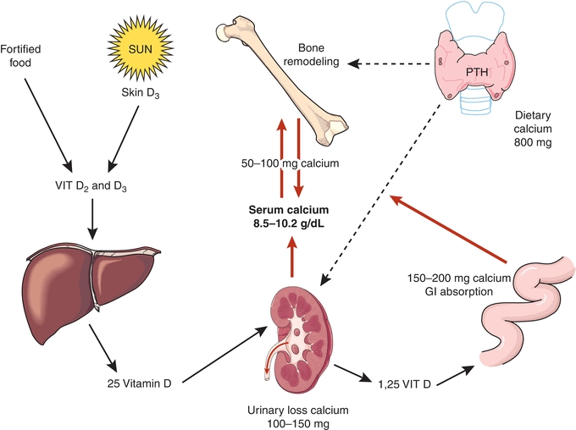

Slide 3
Causes of hypercalcemia
Parathyroid Mediated
Non-parathyroid Mediated
Primary hyperparathyroidism (sporadic)
Inherited variants
MEN syndromes
Familial isolated hyperparathyroidism
Hyperparathyroidism-jaw tumor syndrome
Familial hypocalciuric hypercalcemia
Tertiary hyperparathyroidism (renal failure)
Hypercalcemia of malignancy
PTHrp
Increased calcitriol
Osteolytic bone metastases and local cytokines
Vitamin D intoxication
Chronic granulomatous disorders
Increased calcitriol (activation of extrarenal 1-alpha-hydroxylase)

Slide 4
Medications
Miscellaneous
Thiazide diuretics
Lithium
Teriparatide
Abaloparatide
Excessive vitamin A
Theophylline toxicity
Hyperthyroidism
Acromegaly
Pheochromocytoma
Adrenal insufficiency
Immobilization
Parenteral nutrition
Milk-alkali syndrome

Slide 5
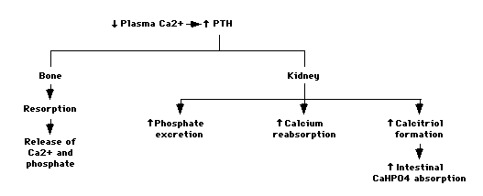
PTH homeostasis
Effect of parathyroid hormone (PTH) on calcium and phosphate metabolism. The net effect is an increase in the plasma calcium concentration with no change or a decrease in the plasma phosphate concentration.

Slide 6
Regulation of PTH secretion
Extracellular calcium
Extracellular phosphate
Calcitriol
Fibroblast growth factor 23 (FGF23).
The change in calcium concentration is sensed by an exquisitely sensitive calcium-sensing receptor (CaSR) on the surface of parathyroid cells.
In normal individuals, a decrease in serum ionized calcium concentration of as little as 0.1 mg/dL produces a large increase in serum PTH concentration within minutes; conversely, an equally small increase in serum ionized calcium rapidly lowers the serum PTH concentration.

Slide 7
CLINICAL PRESENTATIONS of PHPT
Asymptomatic PHPT
Atypical presentations:
Normocalcemic PHPT
Parathyroid crisis.
Classical

Slide 8
HYPERCALCEMIA
Mild: Total Ca 10.5-11.9 mg/dL (2.5-3 mmol/L)
Moderate: Total Ca 12-13.9 mg/dL (3-3.5 mmol/L)
Hypercalcemic crisis: Total Ca 14-16 mg/dL (3.5-4 mmol/L)

Slide 9
Asymptomatic primary hyperparathyroidism
Mean serum calcium concentration <1.0 mg/dL (0.25 mmol/L) above the upper limit of the normal range.
In most patients, serum calcium and PTH levels remain stable.
Nonspecific symptoms, such as fatigue, weakness, anorexia, mild depression, and mild cognitive or neuromuscular dysfunction, and others simply miss work often.

Slide 10
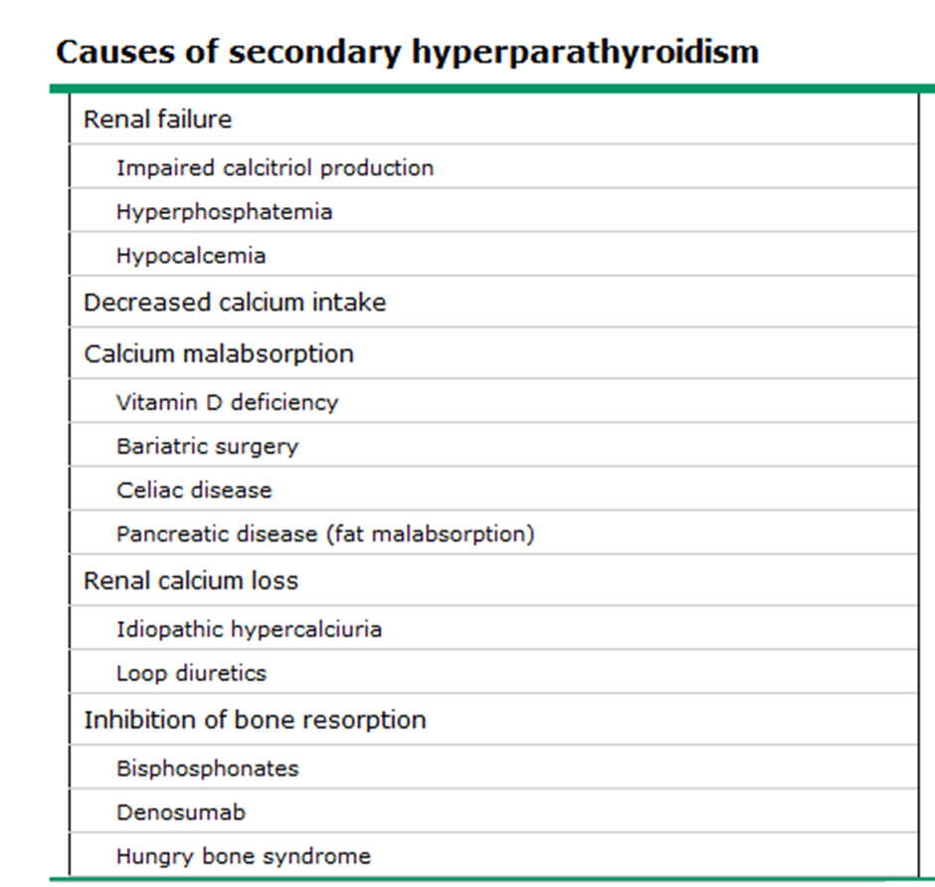
Normocalcemic primary hyperparathyroidism
Phenotype of PHPT in which PTH levels are elevated but total/ionized serum calcium is normal.
All the secondary causes for hyperparathyroidism must be ruled out.
Most of these patients were identified in the course of an evaluation for osteoporosis, fracture, or low bone density
There are no data to suggest that all these patients will ultimately become hypercalcemic, and over what time period.

Slide 11
Parathyroid crisis
Severe hypercalcemia > 15 mg/dL
Mechanism is not known but may be related to
Intercurrent illness (often of a life-threatening nature), volume depletion, or infarction of a parathyroid adenoma.
Marked symptoms of hypercalcemia: in particular, CNS dysfunction. Other clinical problems included severe abdominal pain, nausea, vomiting, peptic ulcer, and pancreatitis.

Slide 12
Classical
Combined effects of increased PTH secretion and hypercalcemia
“Bones, stones, abdominal moans, and psychic groans."

Slide 13
Symptoms and signs of excess parathyroid hormone secretion
Symptoms and signs of hypercalcemia
Bone disease
Nephrolithiasis
Hypophosphatemia
Increased production of calcitriol
Proximal renal tubular acidosis
Hypomagnesemia
Hyperuricemia and gout
Anemia

Slide 14
Clinical manifestations of hypercalcemia
Renal
Polyuria
Polydipsia
Nephrolithiasis
Nephrocalcinosis
Distal renal tubular acidosis
Nephrogenic diabetes insipidus
Acute and chronic renal insufficiency
Gastrointestinal
Anorexia, nausea, vomiting
Bowel hypomotility and constipation
Pancreatitis
Peptic ulcer disease
Musculoskeletal
Muscle weakness
Bone pain
Osteopenia/osteoporosis
Neurologic
Decreased concentration
Confusion
Fatigue
Stupor, coma
Cardiovascular
Shortening of the QT interval
Bradycardia
Hypertension

Slide 15
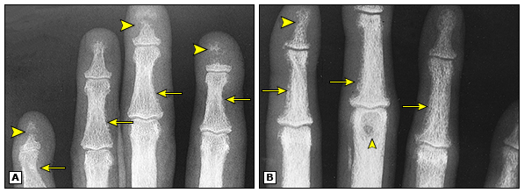
Osteitis fibrosa cystica: Findings on radiograph of the phalanges
Note the radial margins of the proximal and middle phalanges bilaterally are frayed, irregular, and lace-like (arrows) owing to characteristic subperiosteal resorption. Also note the brown tumor (small arrowhead) and osteolysis of the distal phalanges (large arrowheads).

Slide 16
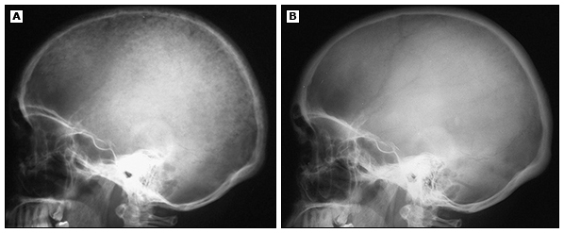
Osteitis fibrosa cystica: Findings on skull radiograph
Skull radiograph shows the typical "salt and pepper" appearance caused by osteitis fibrosa cystica (A). Skull radiograph of same patient six months after removal of the patient's parathyroid adenoma (B). The bones have returned to normal.

Slide 17
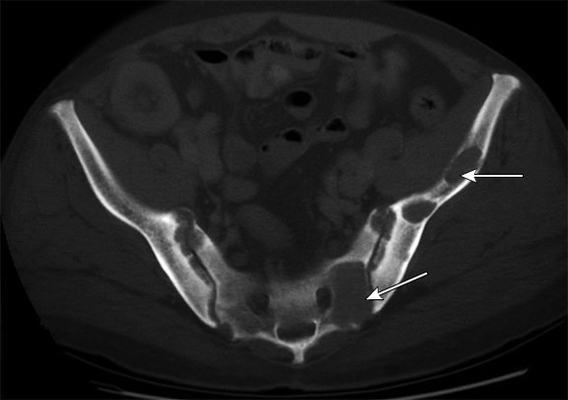
Brown tumors of pelvic bones: Findings on CT
The CT scan of pelvis shows multiple lytic lesions in the pelvis (white arrows) consistent with brown tumors.

Slide 18
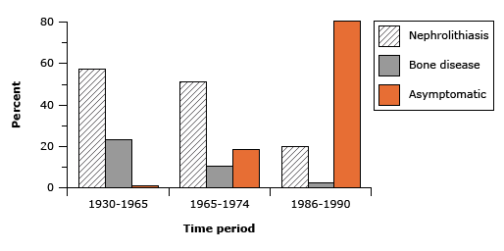
Changing presentation of PHPT
Different patterns of presentation of primary hyperparathyroidism in three different time periods.
The latest survey shows that 80 percent of patients are asymptomatic and discovered incidentally on routine blood screening
Bone disease (osteitis fibrosa cystica), on the other hand, has virtually disappeared as a presenting symptom.

Slide 19
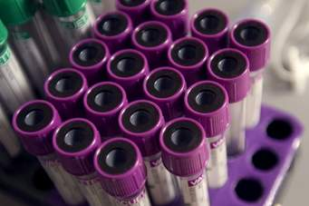
Investigations

Slide 20
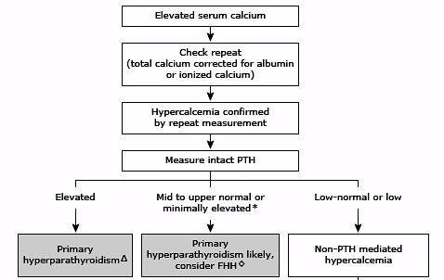
Diagnostic approach to hypercalcemia

Slide 21
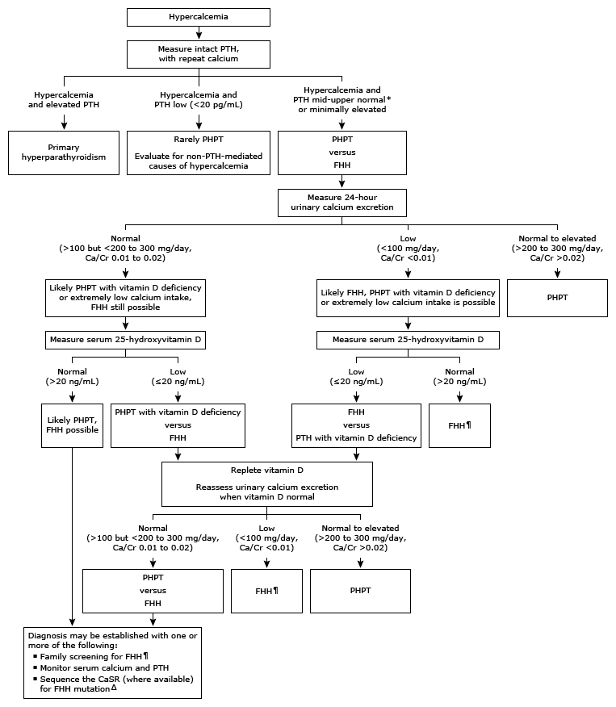
Diagnosis of primary hyperparathyroidism
The major feature that distinguishes FHH from PHPT is a low urine calcium excretion and calcium/creatinine (Ca/Cr) clearance ratio
It is important to make this distinction, however, because FHH is a benign inherited condition that typically does not require parathyroidectomy, nor will it be cured by it.
Ca/Cr clearance ratio = [24-hour urine Ca x serum Cr] ÷ [serum Ca x 24-hour urine Cr]

Slide 22
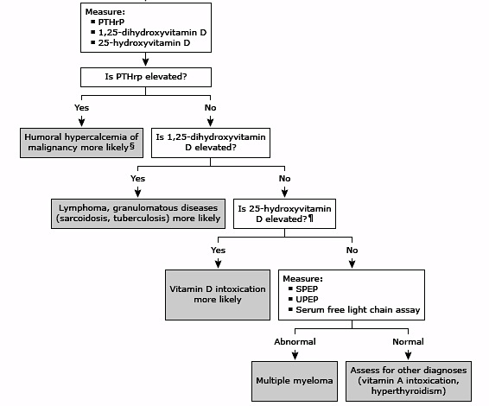

Slide 23
Drugs
Thiazide diuretics
Reduce U. Ca excretion; (mild hypercalcemia up to 11.5 mg/dL)
The drug should be withdrawn, if possible
Calcium and PTH assessed three months later.
Persistent hypercalcemia (with elevated or high-normal PTH) after drug withdrawal suggests that the thiazide has unmasked PHPT.

Slide 24
DRUGS
Lithium
Decreases parathyroid sensitivity to calcium
Hypercalcemia
Hypocalciuria
high serum PTH concentration
Reduces urinary calcium excretion.
Following discontinuation, the serum calcium concentration is more likely to normalize if the duration of lithium use had been relatively short (eg, less than a few years), but less likely if it had been longer (eg, more than 10 years).

Slide 25
Management of PHPT

Slide 26
Parathyroidectomy is the definitive therapy that cures the disease, decreases the risk of kidney stones, improves bone mineral density (BMD), and may decrease fracture risk and modestly improve some quality of life measurements.

Slide 27
Indications for surgery
Symptomatic PHPT
Asymptomatic PHPT (surgery criteria)
Persistent or recurrent PHPT (<6 or >6 months from initial exploration respectively)
Familial PHPT (isolated or as part of MEN)
Parathyroid cancer
Parathyroid cyst (recurrences after aspiration)
Parathyroid crisis (Emergency parathyroidectomy)
Normocalcemic PHPT
Indications for operative intervention are not defined, and currently it is not recommended to use the same criteria used for patients with asymptomatic hypercalcemic PHPT.

Slide 28
Surgery in SYMPTOMATIC patients
Nephrolithiasis
Symptomatic hypercalcemia
Because of the largely subjective nature of these symptoms, the distinction between asymptomatic and symptomatic PHPT is not always clear-cut.
Nonspecific neuropsychiatric symptoms alone are not indications for surgery.

Slide 29
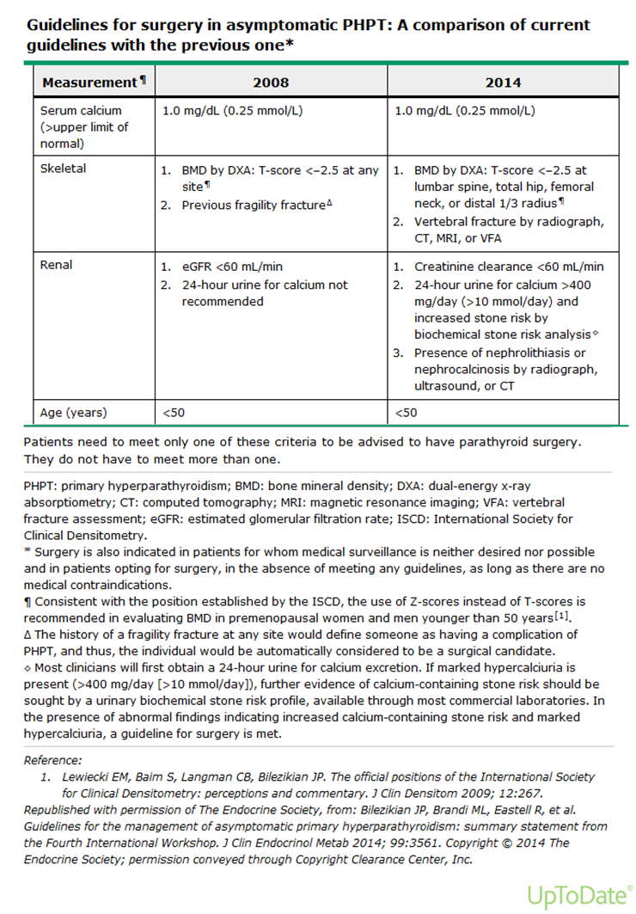

Slide 30
Patients with asymptomatic PHPT who do not meet surgical intervention criteria may still choose parathyroidectomy because it is the only definitive therapy.

Slide 31
Nonoperative management
Avoid factors that can aggravate hypercalcemia:
Prolonged bed rest or inactivity
High-calcium diet (>1000 mg/day).
Encourage physical activity to minimize bone resorption.
Encourage adequate hydration (at least six to eight glasses of water per day) to minimize the risk of nephrolithiasis.
Thiazide, lithium
Volume depletion
Preventive measures

Slide 32
Maintain a moderate calcium intake (1000 mg/day). A low calcium diet may lead to further increases in PTH secretion and could aggravate bone disease. Moderate calcium restriction (eg, <800 mg/day) when the serum calcitriol concentration is high.
Maintain moderate vitamin D intake (400 to 800 IU/d) to maintain a 25[OH]D level of at least 20 or 30 ng/mL. Vitamin D deficiency stimulates PTH secretion and bone resorption and, therefore, is deleterious in patients with PHPT.

Slide 33
Monitoring
Annually
1-2 Years
Serum calcium
Creatinine
eGFR
Bone density (hip, spine, and forearm)

Slide 34
POOR SURGICAL CANDIDATES
Symptomatic /severe hypercalcemia, BMD is not in the osteoporotic range
Osteoporosis and risk for fracture.
If there is no need to improve bone density or to lower the serum calcium
Severe hypercalcemia and very low bone density who are unable to have surgery
Use cinacalcet rather than bisphosphonates
Use bisphosphonates
Do not use pharmacologic therapy
Treatment with both cinacalcet and alendronate is an option.

Slide 35
Calcimimetics
Actions
Indications for use:
Activate the calcium-sensing receptor in the parathyroid gland, thereby inhibiting PTH secretion.
Reduces serum calcium
Does not improve bone density
Treatment of secondary hyperparathyroidism associated with renal failure
Hypercalcemia in parathyroid cancer
Severe hypercalcemia in patients with PHPT unable to undergo parathyroidectomy.

Slide 36
CONCOMITANT VITAMIN D DEFICIENCY
Due to the significant prevalence of vitamin D insufficiency in individuals with PHPT, the Fourth International Workshop on Asymptomatic Primary Hyperparathyroidism recommends measuring 25[OH]D in all patients with PHPT and repleting those with low levels (defined as ≤20 ng/mL [50 nmol/L])
However, there is concern that repleting vitamin D will worsen hypercalcemia and hypercalciuria increasing their risk for kidney stone formation.

Slide 37
Treatment of Severe hypercalcemia
Patients with calcium >14 mg/dL require more aggressive therapy.
Volume expansion with isotonic saline at an initial rate of 200 to 300 mL/hour that is then adjusted to maintain the urine output at 100 to 150 mL/hour.
Administration of salmon calcitonin (4 IU/kg) and repeat measurement of serum calcium in several hours. If a hypocalcemic response is noted, then the patient is calcitonin sensitive and the calcitonin can be repeated every 6 to 12 hours (4 to 8 IU/kg).
The concurrent administration of zoledronic acid (ZA; 4 mg intravenously [IV] over 15 minutes) or pamidronate (60 to 90 mg over two hours), preferably ZA because it is superior to pamidronate in reversing hypercalcemia related to malignancy.

Slide 38
The administration of calcitonin plus saline should result in substantial reduction in serum calcium concentrations within 12 to 48 hours. The bisphosphonate will be effective by the second to fourth day, thereby maintaining control of the hypercalcemia.
Hemodialysis should be considered, in addition to the above treatments, in patients who have serum calcium concentrations in the range of 18 to 20 mg/dL (4.5 to 5 mmol/L) and neurologic symptoms but a stable circulation or in those with severe hypercalcemia complicated by renal failure.
For patients with severe, symptomatic hypercalcemia of malignancy that is refractory to ZA, denosomab is an alternative option.

Slide 39
Thank you

